Slide 1

12th SAARC Payments Council Meeting (Dhaka, Bangladesh -18th November 2012)
“Payment and Settlement Systems in Pakistan”

Slide 2
Contents
Brief background and Update on International Banks Account Number (IBAN)
New ATMs linked with Branch Opening
Development on Branchless Banking
Latest E-Banking Trends
Other issues
Projects in Hand

Slide 3
IBAN
Brief Introduction - recap
    International Bank Account Number is an international standard (ISO 13616-1:2007) for identifying bank accounts across borders.
    The IBAN facilitates communication and processing of fund transfer related transactions. It allows exchanging account identification details in a machine-readable form and facilitates STP.
  Already implemented in more than 50 countries (including EU, Saudi Arabia, Kuwait, U.A.E. etc.)
  IBAN comprises of 34 digit (maximum) code which uniquely identifies Country, Bank, Branch and Account Number.

Slide 4
IBAN
Before IBAN
  No Domestic Account Code Standard exists.
  Account Number length and formulation varies from bank to bank. Maximum bank account digits are 20 while minimum bank account digits are 8.
  Each financial institution applies its own account number structure for all products and payment instructions.
  In electronic transmissions, the bank and branch codes are included in separated fields. ATM Switches assign their own codes and NIFT its own codes for each bank.

Slide 5
IBAN-implementation Challenges
    Banks need to make changes in their Core Banking Applications in order to implement IBAN Standard. This potentially can have significant cost implications for banks especially if foreign vendors are involved in application development.
    Bank will also need to implement IBAN in Alternate Delivery Channels (ADCs) such as Internet Banking, Phone Banking, and ATMs etc. As different ADC applications are used by banks, therefore multiple vendors are involved in configuration of these applications.
    Awareness campaigns for customer regarding IBAN use in financial transactions. Communication of IBAN, especially to overseas Pakistanis for using IBAN in all foreign remittances transactions will be a major challenge

Slide 6
IBAN-implementation Challenges
  Banks have shown reservations on IBAN use for domestic transactions. SBP, however, is of the view that maintaining two separate accounts is not practical for customers. IBAN use for domestic transactions, moreover, will enable financial sector to introduce/implement straight through processing in existing and future electronic payments instruments such as electronic credits transfers, direct debits etc.
    Training of front line staff at banks will also be required in order to handle queries by customers regarding IBAN besides handling/validating payments containing IBAN. SBP, in this connection, is providing training in coordination with Institute of Bankers (IBP) to all banks for IBAN generation and validation.

Slide 7
IBAN
Proposed timelines for implementation
Phase 1 – December 2012
Commercial banks shall generate and notify IBAN to all their customers by December 2012.
Phase 2 – June 2013
IBAN will be operationally used (capturing, recognition, processing, validation, transfer) both for domestic as well as for international financial transactions by June, 2013.

Slide 8
New ATM linked with branch opening
Increasing the coverage ratio of ATMs in Pakistan
In order to increase the coverage ratio of ATM across the country,
SBP has decided that from CY 2013 onwards, all banks shall add
one ATM in their network against each new branch to be opened
in a CY. For this purpose, those banks having less than 1:1 ATM
per branch ratio shall cover their existing gap in 5 years time
starting from CY 2013 @ 20% each year.

Slide 9
Progress in Branchless banking
More than 28 million transactions worth of Rs. 115.3 billion have been processed during the 2nd Quarter of 2012
Agents‟ network has grown to 29,525 spreading across almost 90% districts of Pakistan
Number of mobile banking accounts has reached at 1.45 million, experiencing a remarkable growth of 37% during 2nd Q of 2012
Six more banks have obtained approval for branchless banking and entered in the pilot phase before rolling out their full-scale BB operations.

Slide 10
No. of BB Accounts as of 30th June 2012
Male |  | Female | Total
Level 0 | 19,269 | 336,435 | 355,704
Level 1 | 900,878 | 111,409 | 1,012,287
Level 2 | 46,600 | 2,836 | 49,436
Level 3 | 29,882 | 72 | 29,954
Total | 996,629 | 450,752 | 1,447,381
Level 0: Basic BB Account with low KYC requirements and low transaction limits
Level 1: Entry Level account with adequate KYC requirements commensurate with transaction limits.
Level 2: Top level account for individuals as well as businesses offering all BB facilities and subject to full KYC requirements
Level 3: Account specific for merchants, businesses, banking agents, technology service providers and corporations. These accounts may also be utilized for various disbursements like salaries/payrolls, pensions, grants, donations etc.

Slide 11
Latest E-Banking Trends

Slide 12
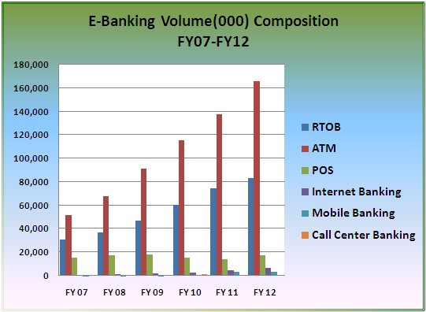
E-banking Volume composition

Slide 13
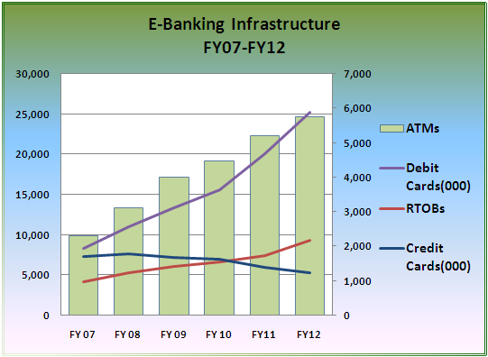
E-Banking Infrastructure

Slide 14
other issues
Challenges Regarding ATM Operations
    ATM skimming device cases
    Fake currency notes disbursement through ATMs
    ATM downtime management issues due to current energy crises in the country

Slide 15
Projects in hand
Regulations for Mobile Banking and Third Party Service Providers.
2FA guidelines.
Working on pre-paid card guidelines.
Inter-operability for IBFT between 1-Link and M-Net.
Working on domestic financial switch/gateway.

